Slide 1

How to Start A Business:
Tips for Students and Aspiring Young Entrepreneurs
CAMBODIA SPEAKER PROGRAM
October 7-11, 2013
Steve Mariotti, Founder
NFTE

Slide 2
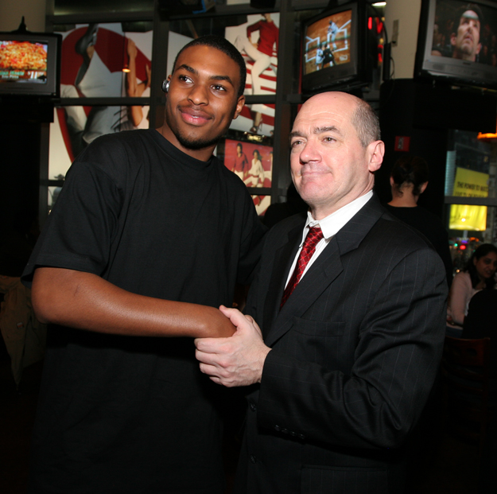

Entrepreneurship Education: An Idea with Global Reach
In 1982, after getting mugged by teenagers who took $10 from
him, Steve Mariotti, NFTE’s Founder, realized he had to help youth
find a better way.
Having been both a Ford Motor Company finance analyst and
an import/export entrepreneur, Steve made a significant career
change and became a special education/business teacher in the
New York City public school system.
Teaching in notorious neighborhoods such as Bedford-Stuyvesant
in Brooklyn and Fort Apache in the South Bronx, Steve’s greatest
challenge was reaching his students and keeping them engaged in
learning.
Frustrated one day, Steve went to what he knew best: sales. When he
started talking that language by selling his watch to his class, they were
mesmerized.
From this moment a unique insight was born: Entrepreneurship
education connects learning to the real world and is particularly
motivating for economically disadvantaged youth.
In 1987, Steve founded the Network for Teaching Entrepreneurship.
"Our program transforms street smarts into business smarts.“
Steve Mariotti
NFTE Founder

Slide 3
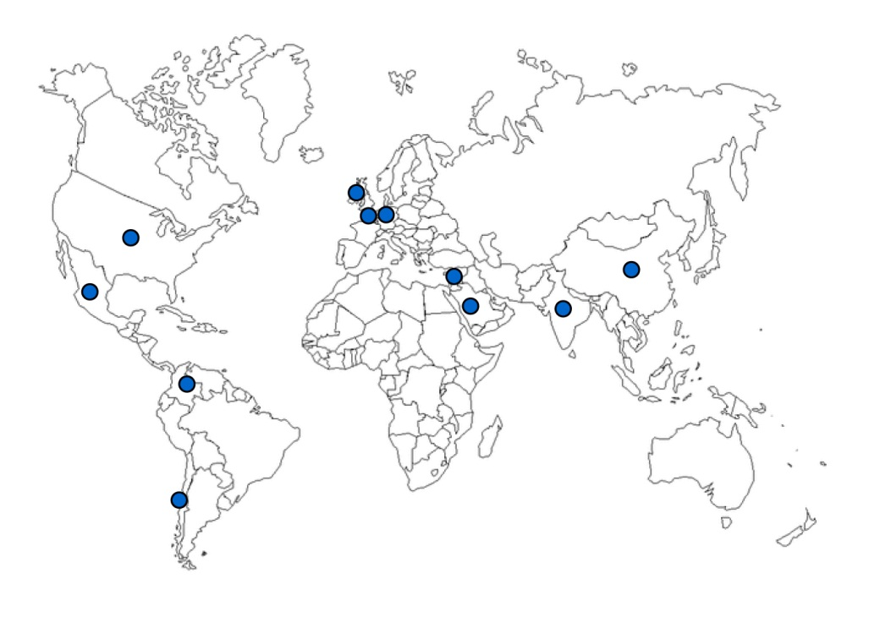
NFTE Today
NFTE’s mission is to provide programs that inspire young people from low-income communities to stay in school, to recognize business opportunities and to plan for successful futures. Our vision is that all young people can be entrepreneurial leaders.
500,000
Students served worldwide
5,000
Teachers trained in 50 countries
United States
Atlanta
Baltimore
Bay Area
Chicago
Cleveland
Dallas
Fairfield Co., CT //
Westchester Co., NY
Fresno
Kansas
Los Angeles
Newark
New England
New York City
Philadelphia
Pittsburgh
South Carolina
South Florida
St. Louis*
Washington DC
International
Belgium
Chile
China
Colombia
France*
Germany
Great Britain*
India
Ireland
Israel
Mexico*
Saudi Arabia
* launch phase
Founded in 1987
NYC Headquarters
Serves low-income young people ages 11 to 18
19 U.S. program sites
12 international program sites
$17 million budget
475 active U.S. teachers; 800 active teachers overseas
Middle school, high school, community college and college level curriculums authored by NFTE Founder Steve Mariotti
High school curriculum awarded 2010 best math curriculum for grades 9-12 by AEP
Notes:
NFTE began in one classroom in New York City. Today, NFTE has a presence in 19 domestic sites and 12 international sites, as demonstrated on this map. NFTE has trained teachers in 50 countries. To date, NFTE has worked with half a million young people to develop in them an entrepreneurial mindset and critical skills for successful futures. NFTE has published award-winning curriculum in partnership with Pearson for use in middle schools, high schools, and colleges.
NFTE is also seen as a thought leader in the field of entrepreneurship education for young people. The White House granted NFTE with membership in the Startup America partnership and President Obama appointed NFTE CEO Amy Rosen to the President’s Advisory Council on Financial Capability, where she serves as Vice Chair of the Council and Chair of the youth subcommittee. Our work and alumni success stories have been featured by numerous media outlets, including the Wall Street Journal, the New York Times, MSNBC, CBS, ABC, Time Business, and Fox Business.

Slide 4
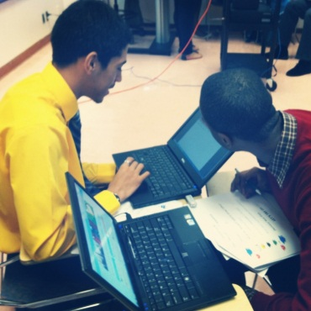

Entrepreneurship Education: A Global Solution
As the demand for entrepreneurship programming has grown in response to global economic and educational challenges, there is an emerging opportunity for NFTE to expand its vision, its reach and its impact.
Global Challenges Addressed by Youth Entrepreneurship Education
75 million youth (ages 15-24) are unemployed globally.
More than 6 million young people around the world have given up looking for a job altogether.
The Middle East and North Africa (MENA) region has the highest youth unemployment rate, with approximately one in four young people without a job.
25% of recent university graduates in China are unemployed.
In Europe, some 4 million jobs available today have not been filled because of “mismatch between the skills of the unemployed and the skills required.”
Half of the 1.2 billion population of India is below the age of 25; the youth unemployment rate is above 10%.
33% of U.S. youth do not finish high school; 50% for minority youth.
NFTE CREATES ENTREPRENEURIAL CITIZENS
Opportunity focused
Solution driven
Holistic thinkers
Adaptable skills
Notes:
NFTE today faces an unprecedented need for entrepreneurship education to support the United States and global economy in its fragile economic recovery and to build a new generation of young people equipped with the skills needed to succeed in college, career and life. NFTE has a unique opportunity to expand its offerings and delivery mechanisms to reach a larger number of young people with a portfolio of products and services derived from 25 successful years in the field. We have set the goal of reaching one million young people by 2017.

Slide 5
TEN CONCEPTS EVERY STUDENT SHOULD LEARN ABOUT BUSINESS
The importance of mental and physical health
The Joy of Business and Opportunity Recognition
The “Economics of One Unit”
Don’t compete, create a comparative advantage
Marketing: putting yourself in the customer’s shoes
Leadership and giving back
Financial Statements (ROI and Breakeven)
The Basic Sales Call
How to Write a Business Plan
The “Rule of 72”
Notes:
NFTE today faces an unprecedented need for entrepreneurship education to support the United States and global economy in its fragile economic recovery and to build a new generation of young people equipped with the skills needed to succeed in college, career and life. NFTE has a unique opportunity to expand its offerings and delivery mechanisms to reach a larger number of young people with a portfolio of products and services derived from 25 successful years in the field. We have set the goal of reaching one million young people by 2017.

Slide 6
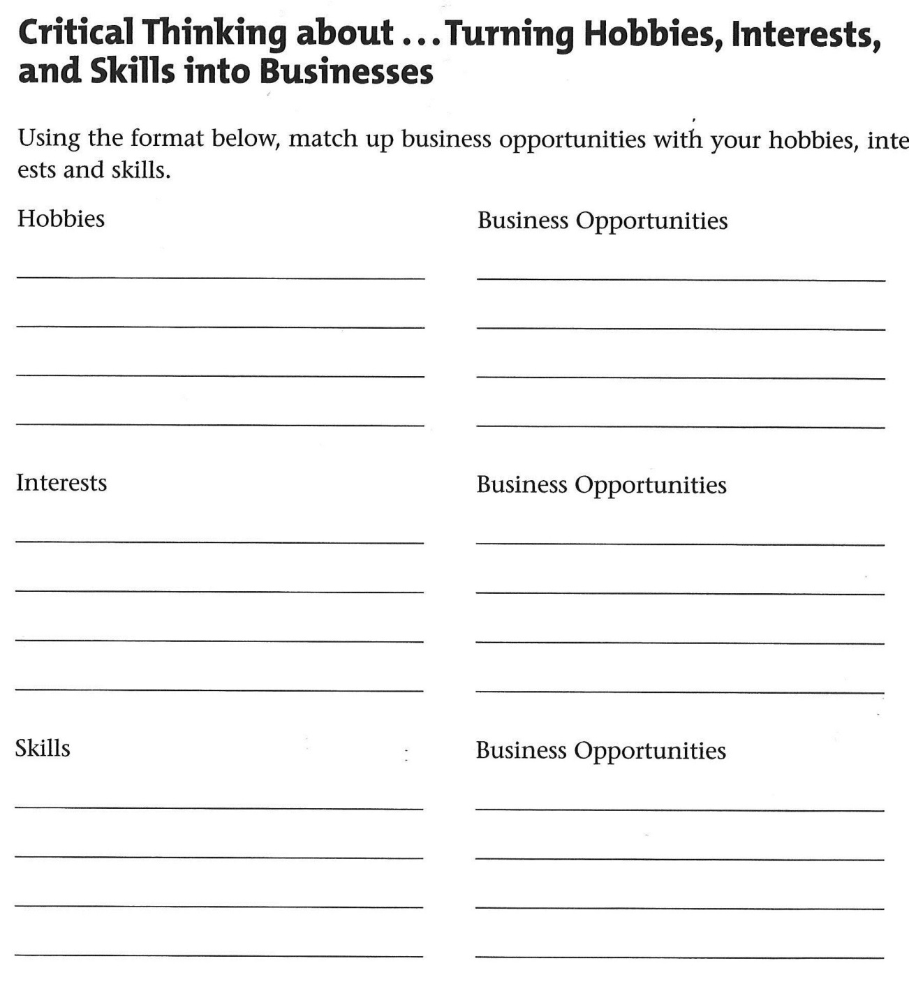

Slide 7
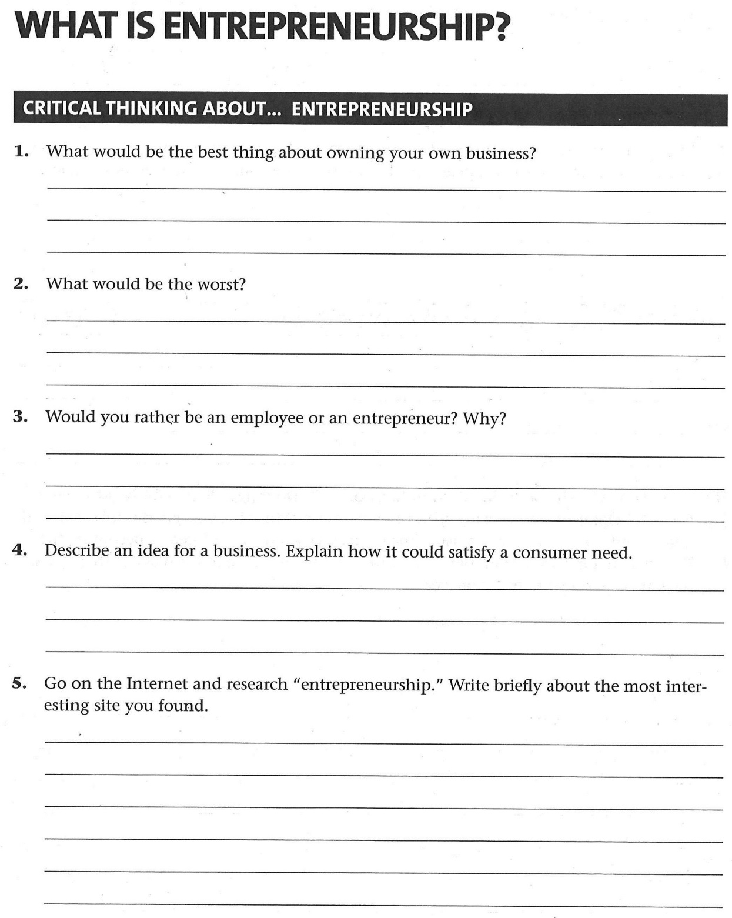

Slide 8
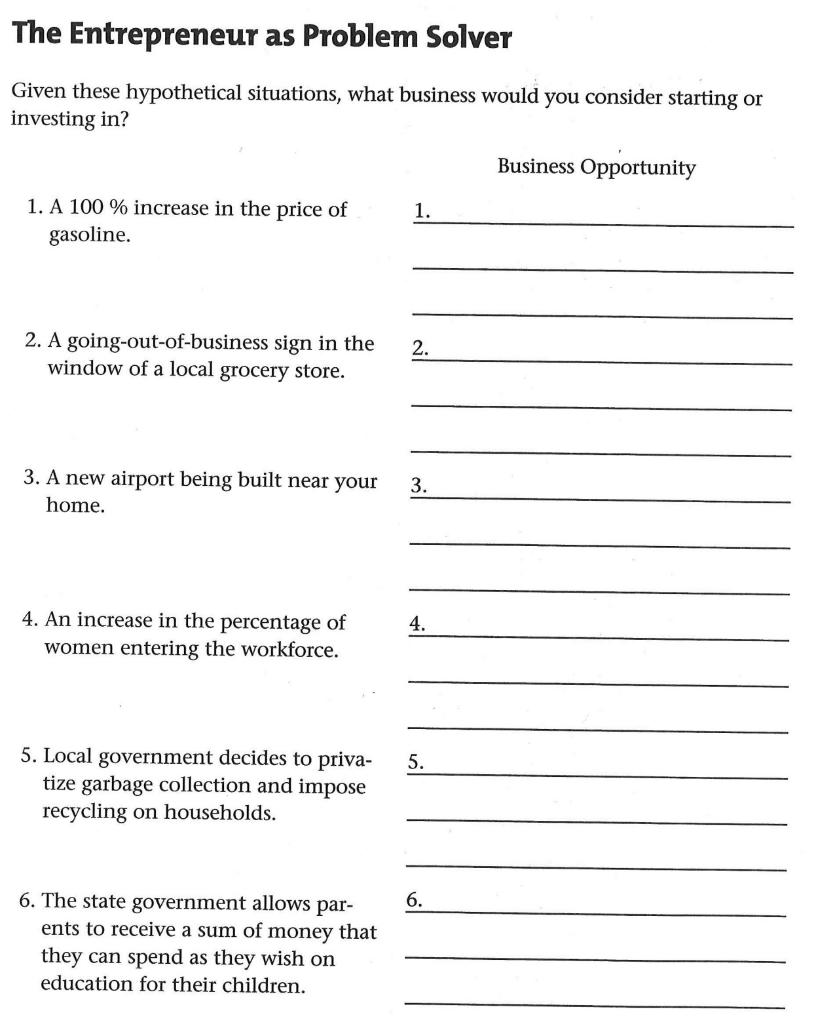

Slide 9
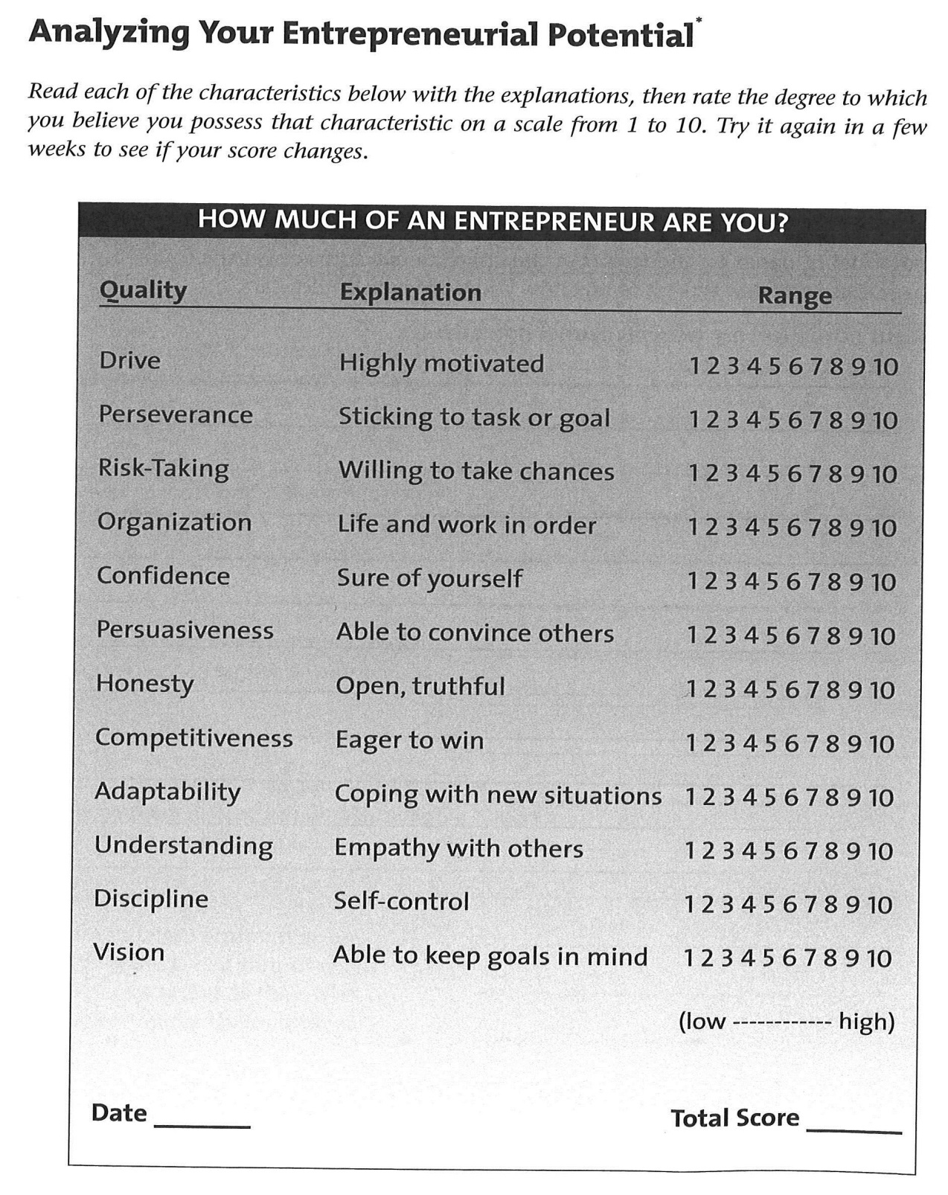

Slide 10
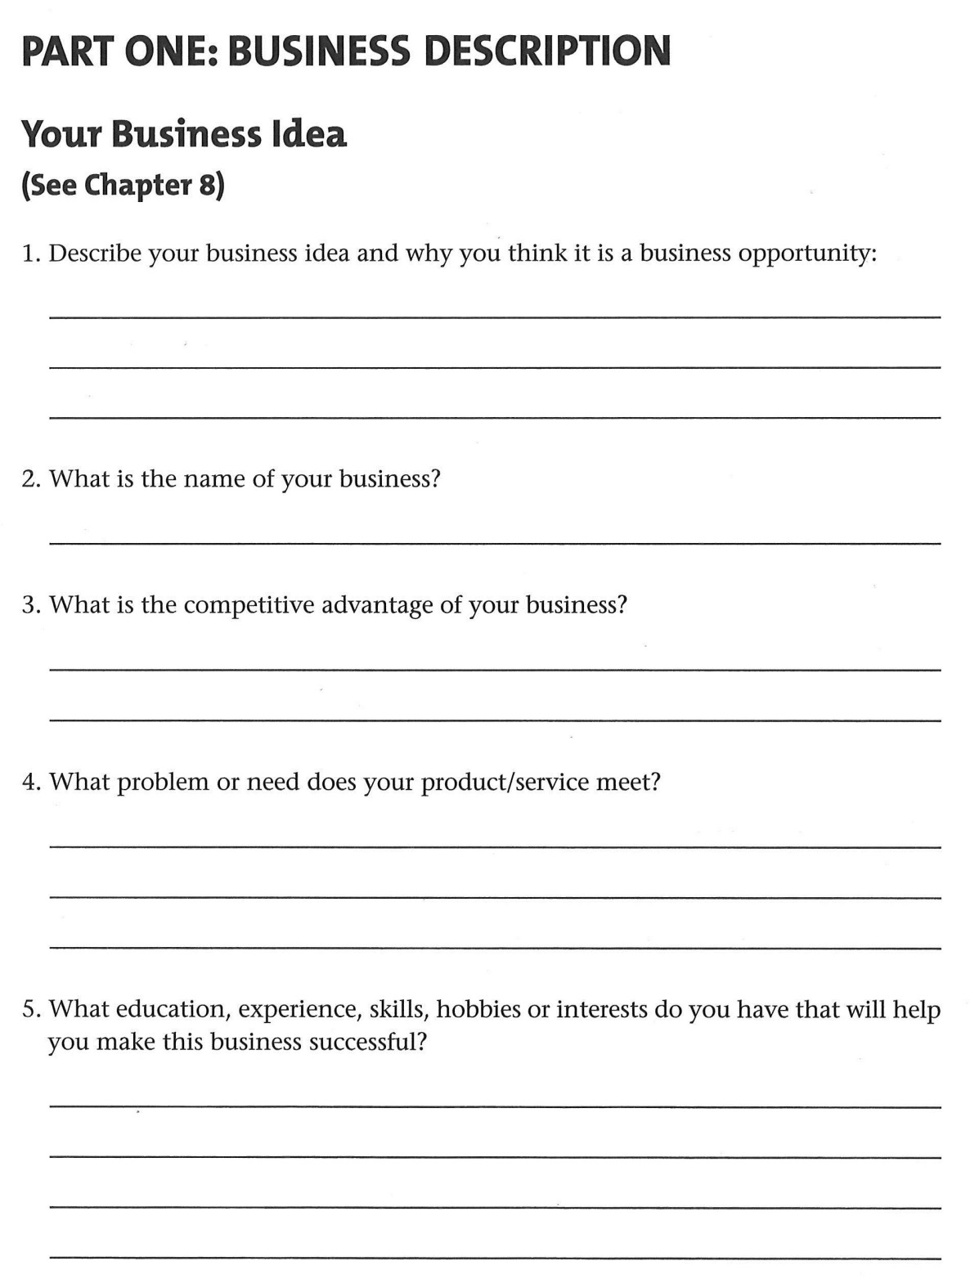

Slide 11
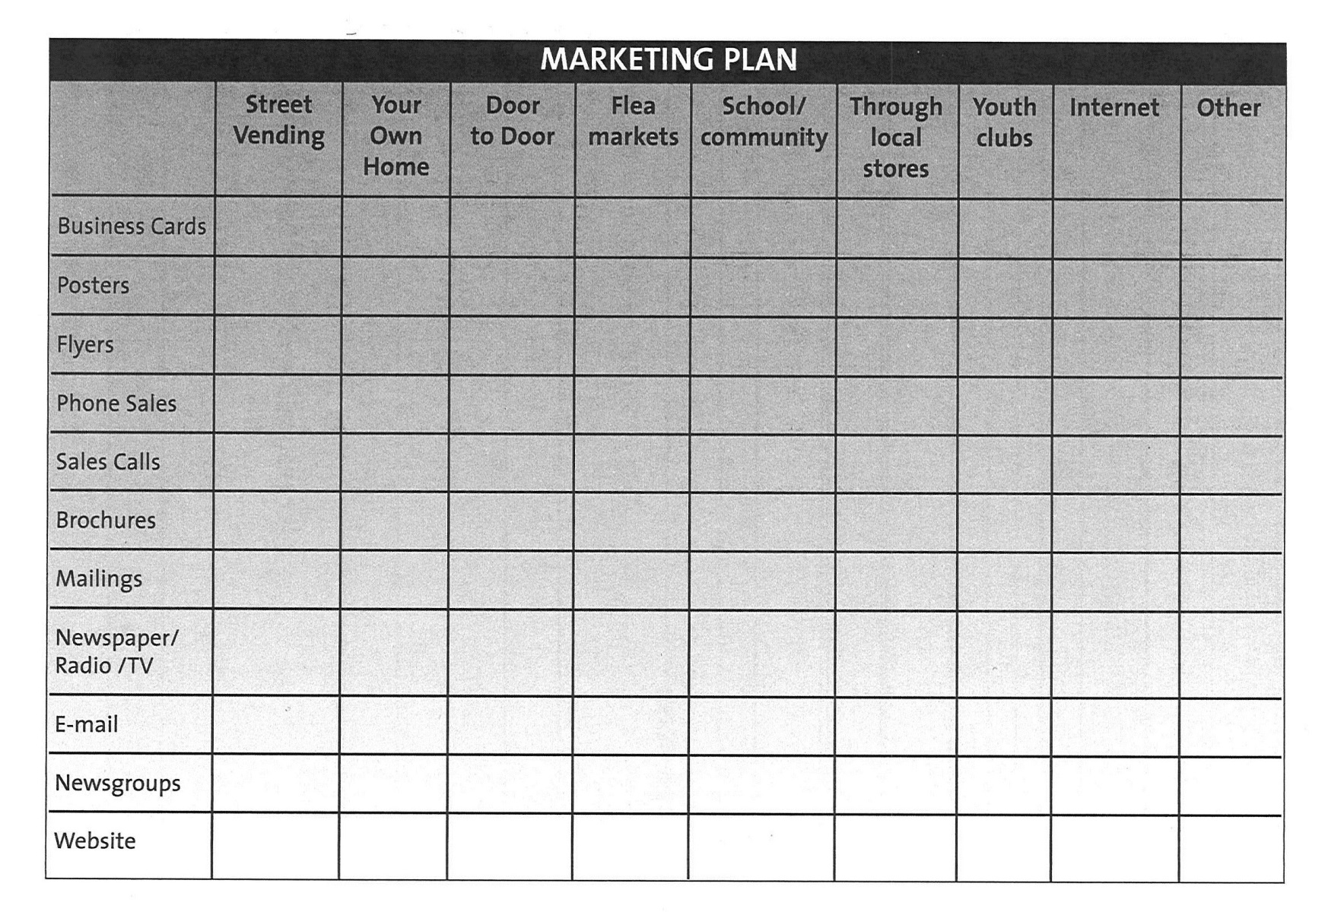
MARKETING PLAN

Slide 12
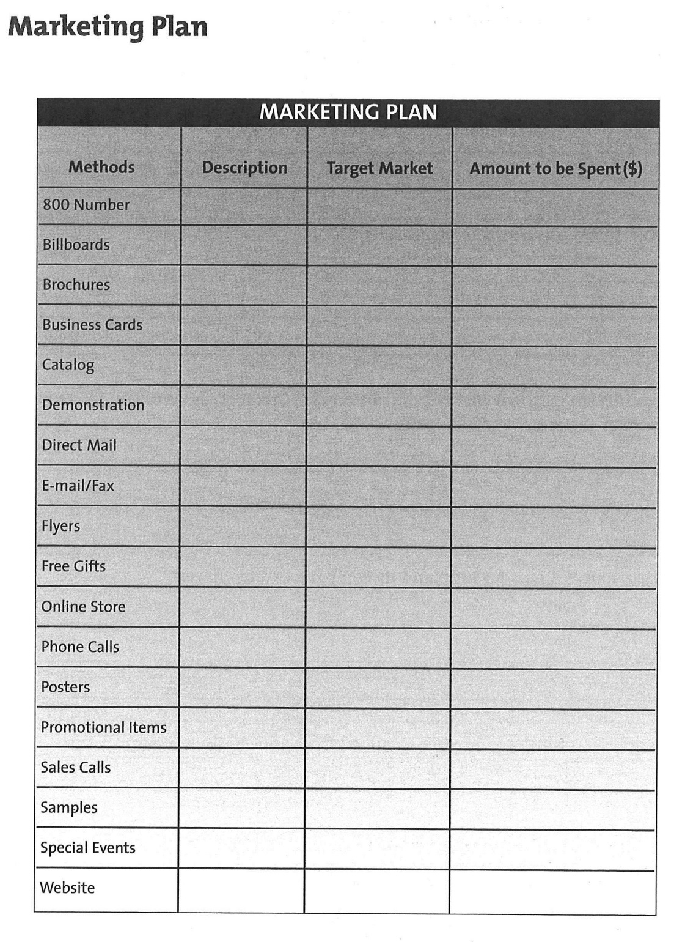

Slide 13
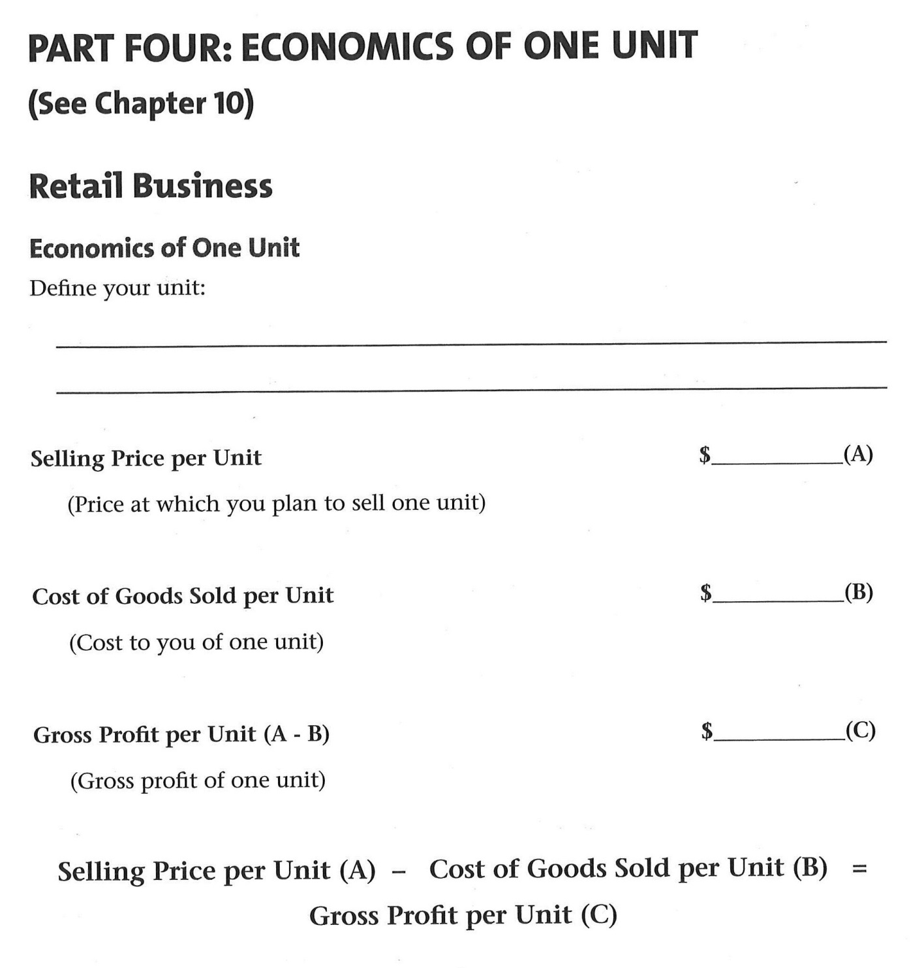

Slide 14
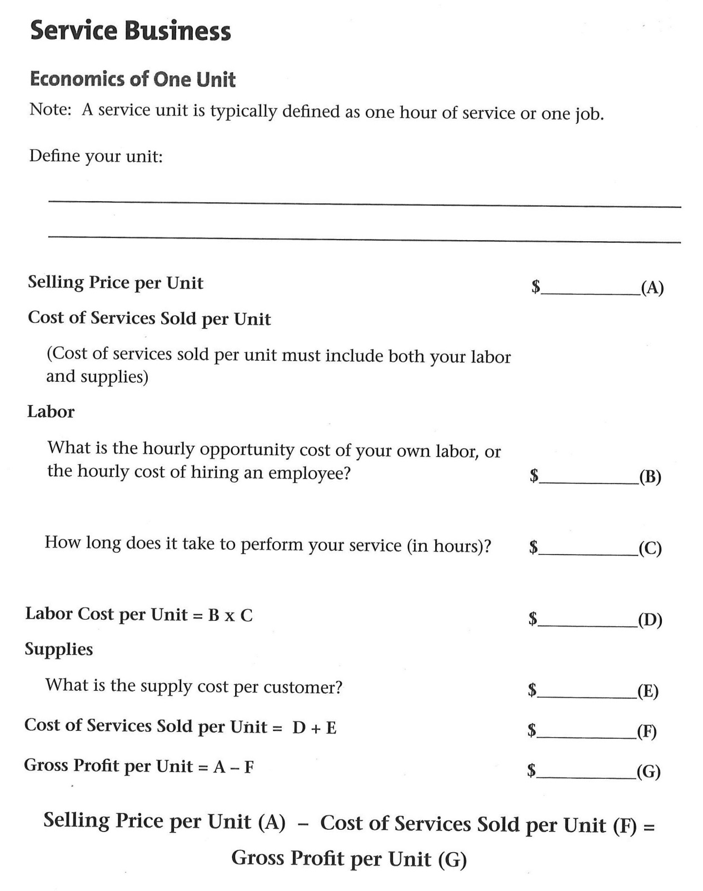

Slide 15
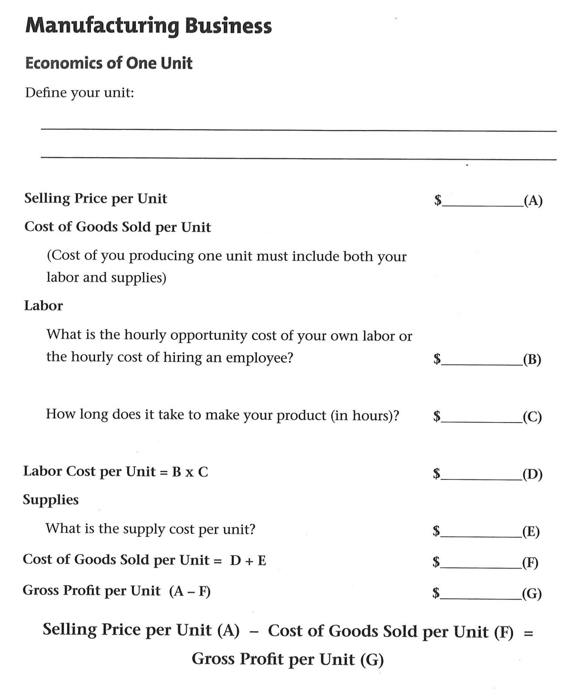

Slide 16
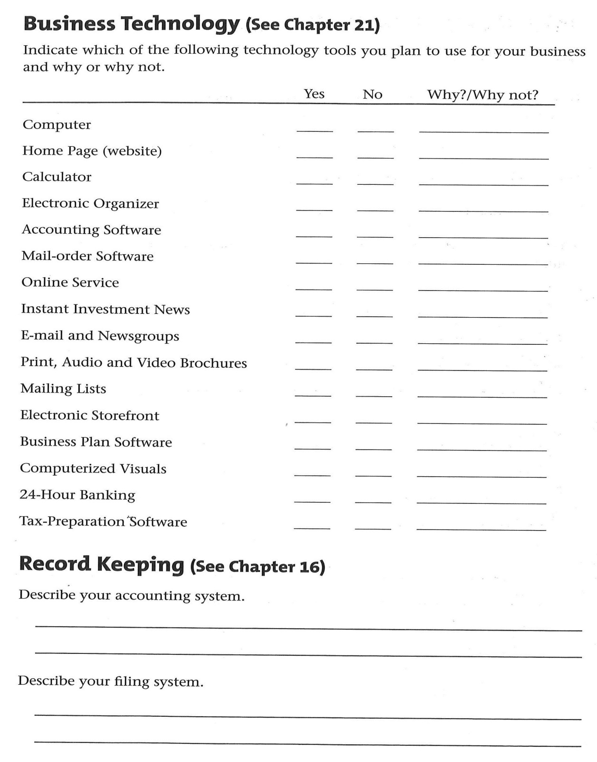

Slide 17
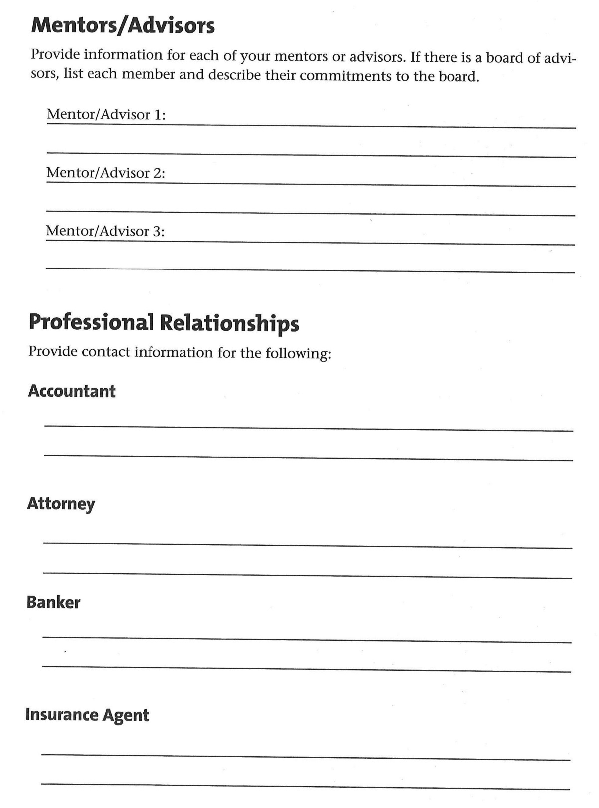

Slide 18
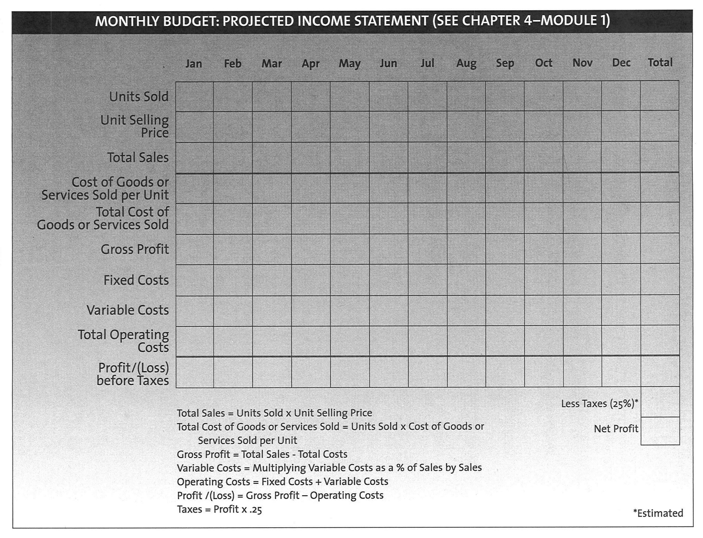

Slide 19
